Slide 1
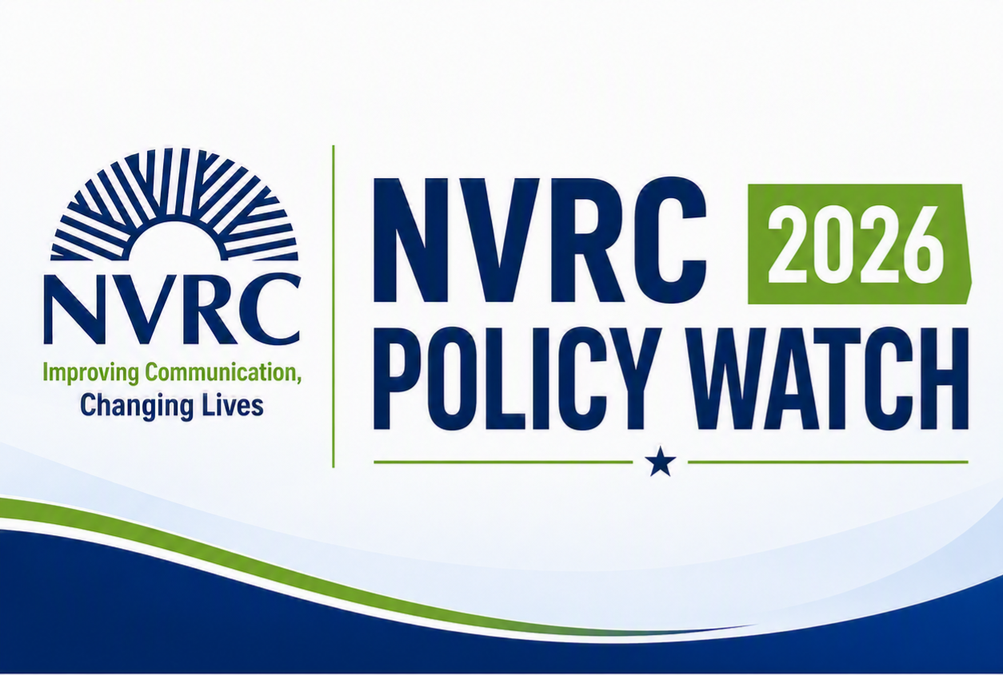
New Laws & Policy Changes You Should Know About
Presented by Darren Marquardt
Executive Director
Northern Virginia Resource Center for Deaf & Hard of Hearing Persons
Notes:
Good evening, everyone, and thank you for being here.
My name is Darren Marquardt, and I'm the Executive Director of the Northern Virginia Resource Center for Deaf and Hard of Hearing Persons, or NVRC.
Today we're going to spend about 45 minutes looking at the policy changes that affect our community—from the federal level, to Virginia, to right here in Northern Virginia.
When people hear the word policy, they often think it's complicated or only relevant to lawyers and elected officials. But policy affects all of us every day.
It affects whether we have access to interpreters or captions.
It affects healthcare.
It affects employment.
It affects transportation.
It affects the services available in our communities.
My goal today isn't to turn anyone into a policy expert.
My goal is to help you understand what's changing, what it means for you, and where we're headed next.
Some of these changes are exciting.
Some are challenging.
Many are still evolving.
By the end of today, I hope you'll leave with a clearer understanding of how these policies connect to your everyday life.
Let's begin by talking about why this matters.

Slide 2
Why This Matters
Policy decisions affect:
Your civil rights
Your healthcare
Your employment
Your communication access
Your insurance and benefits
Your local services
Your independence
Today’s goal:
to make complicated policy changes clear, relevant, and useful to our community.
Notes:
Before we jump into specific laws and policies, I want to answer one simple question:
Why should any of us care about policy?
Because policy isn't just something that happens in Richmond or Washington, D.C. Policy shapes our everyday lives.
It determines whether communication access is available when we go to a doctor's appointment.
It influences the accommodations we receive at work or in school.
It affects what services are available in our communities, what programs receive funding, and what protections exist under the law.
Sometimes those changes are obvious, like Virginia's new Open Caption Law.
Other times they're much quieter—changes in funding, agency priorities, court decisions, or local budgets that gradually affect the services we rely on.
The good news is that many positive things are happening.
The challenge is that not every change makes the evening news. Many important policy changes happen quietly, and unless you're paying attention, you may never know that a new right exists or that a service has changed.
That's why today's presentation is really about helping you stay informed.
The more we understand what's changing, the better prepared we are to advocate for ourselves, our families, and our community.
Let's start by looking at what we'll cover today.

Slide 3
What We'll Cover
✔ Federal changes
✔ Virginia legislation
✔ Northern Virginia updates
✔ Communication access
✔ Healthcare
✔ Employment
✔ Technology & AI
✔ What to watch next
Notes:
Before we dive in, I want to give you a roadmap for where we're going today.
We'll start at the federal level, because federal laws create the foundation for many of the rights and protections we rely on. We'll talk about the Americans with Disabilities Act, Section 504, the Olmstead decision, healthcare, communication access, and some of the emerging issues surrounding artificial intelligence.
Then we'll move to Virginia, where we'll look at new legislation—including one of the biggest accessibility victories our community has seen in years: the Open Caption Law. We'll also touch on several other state policy changes that may affect individuals, families, employers, and service providers.
After that, we'll bring the discussion closer to home by looking at Northern Virginia. Every county and city makes decisions about budgets, programs, transportation, aging services, and community investments. Those local decisions often have a direct impact on the services available to Deaf and Hard of Hearing residents.
Finally, we'll step back and look at the big picture—what all of these changes mean, where we see opportunities, and how each of us can help build a more accessible and inclusive community.
As we go through today's presentation, please don't worry about trying to remember every detail. My goal isn't for you to memorize laws or policy changes. Instead, I hope you leave with a better understanding of what's changing, why it matters, and where to go if you have questions.
Let's begin with the foundation of disability rights in the United States: the Americans with Disabilities Act.

Slide 4
Federal Policy Watch
The ADA remains federal law.
However...
Enforcement priorities can change.
Federal guidance can change.
Court interpretations can change.
Agency staffing can change.
This is why paying attention matters.
ADA:
Still the Law
People are asking:
"Is the ADA going away?"
No.
Notes:
Let's start with one of the questions I've heard more than any other over the past year.
"Is the ADA going away?"
The short answer is no.
The Americans with Disabilities Act is a federal civil rights law. It doesn't disappear because a new President takes office or because Congress changes.
So why are people asking this question?
Because they hear about changes in Washington. They hear about lawsuits. They hear about executive orders. They hear about agencies being reorganized or staff reductions. It's easy to wonder whether our rights are changing.
The important thing to understand is this:
The law remains the same.
What can change is how the law is enforced.
A new administration may emphasize different priorities. Federal agencies may issue new guidance. Courts may interpret the law differently over time. Some cases move forward while others receive less attention.
So while the ADA isn't going away, the way it's implemented and enforced can evolve.
That's why it's important to stay informed—not because our rights disappear overnight, but because understanding changes in enforcement helps us know what to expect and how to advocate effectively.
On the next slide, let's look at the ADA issues that are most relevant to our community.

Slide 5
ADA Issues to Watch
• Effective Communication
• Qualified interpreters
• CART
• Captioning
• Hearing loops
• Accessible technology
• Hospital communication
• Public accommodations
• Employment accommodations
Notes:
These are the areas I encourage everyone to pay the closest attention to over the next few years.
The first is effective communication.
The ADA doesn't simply require organizations to communicate—it requires communication to be effective. That means communication should be as effective for a Deaf or Hard of Hearing person as it is for everyone else.
How that happens depends on the individual and the situation.
Sometimes that means a qualified ASL interpreter.
Sometimes it means CART captioning.
Sometimes it means assistive listening technology, hearing loops, captioning, or other accommodations.
Healthcare continues to be one of the biggest areas of concern.
Many hospitals and medical providers are improving, but communication breakdowns still occur far too often.
Employment also continues to evolve as more workplaces use virtual meetings, AI-generated captions, and hybrid work environments.
Technology is creating exciting new opportunities, but it doesn't replace the obligation to provide effective communication.
Throughout this presentation you'll notice one recurring theme:
Communication access isn't one-size-fits-all.
Different people need different solutions, and the law recognizes that.
Another important law works alongside the ADA, and many people don't realize how often it applies.
Let's look at Section 504.

Slide 6
Section 504
Hospitals and medical offices that receive Medicare or Medicaid funding
Public schools (K-12)
Colleges and universities
Community colleges
Public libraries
State and local government agencies
Public health departments
Workforce development and employment programs
Housing authorities
Transit agencies receiving federal funding
Senior centers and Area Agencies on Aging Vocational rehabilitation programs
Community mental health providers
Federally qualified health centers (FQHCs)
Nonprofit organizations that receive federal grants
Emergency management programs funded by FEMA
Parks and recreation programs receiving federal assistance
What is it?
Civil rights protections for people with disabilities in programs receiving federal funding.
Why it matters:
Nearly every Deaf and Hard of Hearing person interacts with organizations covered by Section 504.
Notes:
Most people have heard of the ADA.
Far fewer people know about Section 504 of the Rehabilitation Act, even though it affects many of the places we visit every week.
Section 504 says that organizations receiving federal financial assistance cannot discriminate against people with disabilities.
Think about how many places receive federal funding.
Hospitals.
Medical clinics.
Public schools.
Colleges and universities.
Libraries.
Transit systems.
Health departments.
Senior centers.
Many nonprofit organizations.
Housing authorities.
Even emergency management programs.
For many people, Section 504 is actually the law they encounter most often in everyday life.
For example, if you go to INOVA, Sentara, or Virginia Hospital Center, Section 504 applies because those hospitals receive Medicare and Medicaid funding.
If your child attends public school, Section 504 applies.
If you're taking classes at NOVA or George Mason University, Section 504 applies.
The important takeaway is this:
The ADA and Section 504 work together.
The ADA covers many public and private entities.
Section 504 specifically applies to organizations that receive federal funding.
For many organizations, both laws apply, providing multiple layers of protection for people with disabilities.
Next, we'll look at an important Supreme Court decision that continues to shape disability services across the country—the Olmstead decision.

Slide 7
Olmstead
The Supreme Court said:
People with disabilities have the right to receive services in the most integrated setting appropriate.
What does that mean?
Living in the community
Avoiding unnecessary institutionalization
Equal opportunity
Current policy discussions could affect how this principle is interpreted.
Notes:
One of the most important disability rights decisions you've probably never heard of is called the Olmstead decision.
In 1999, the U.S. Supreme Court ruled that people with disabilities have the right to receive services in the most integrated setting appropriate to their needs.
In simple terms, people shouldn't be unnecessarily separated from their communities simply because they have a disability.
Instead, whenever appropriate, services should be provided where people live, work, learn, and participate in everyday life.
For the Deaf and Hard of Hearing community, that principle shows up in many different ways.
It supports access to community-based services instead of requiring people to travel long distances.
It encourages communication access in mainstream healthcare, employment, education, and recreation.
It reinforces the idea that accessibility should exist where life happens—not only in specialized settings.
At NVRC, this philosophy influences much of what we do. Whether we're providing outreach, technology demonstrations, advocacy, or community education, our goal is to help people remain connected to their own communities.
Olmstead reminds us that inclusion isn't just a nice idea—it's a civil right.
Now let's look at another area where federal policy has become increasingly important: healthcare.

Slide 8
Medicaid & Medicare
Potential changes affecting:
Hearing services
Home and community-based services
Long-term supports
Older adults
Funding stability
Important reminder:
Some proposals become law. Many never do.
Notes:
Healthcare policy is one of the areas we watch most closely because changes to Medicare and Medicaid can affect so many people in our community.
These programs help fund hearing-related services, home and community-based services, long-term supports, and many of the programs that older adults and people with disabilities rely on every day.
If you've been following the news, you've probably seen headlines about proposed changes to these programs.
One of the most important things to remember is what's at the bottom of this slide:
Some proposals become law. Many never do.
It's easy to read a headline or see something on social media and think a program has already changed, when in reality it's simply being discussed.
That's why it's important to separate proposals from actual policy changes.
Here at NVRC, we keep an eye on these discussions because if something does become law, we want our community to understand what has changed, who it affects, and what resources may be available.
The good news is that, right now, many of these discussions are still exactly that—discussions.
Next, let's shift from healthcare funding to another topic that's central to everything we do: communication access.

Slide 9
Communication Access
Communication Access
Is More Than Interpreters
ASL
CART
Captioning
Hearing loops
Assistive Listening Systems
Speech-to-Text apps
Clear masks
Accessible documents
Notes:
When many people think about communication access, the first thing that comes to mind is an ASL interpreter.
Interpreters are incredibly important, but communication access is much broader than that.
Our community is incredibly diverse. Some people communicate primarily in American Sign Language. Others use spoken English with hearing technology. Some rely on CART captioning. Others benefit from hearing loops, assistive listening systems, speech-to-text apps, clear masks, or accessible written materials.
There isn't one accommodation that's right for everyone.
The law doesn't require the same accommodation for every person—it requires effective communication. The right accommodation depends on the individual, the situation, and what allows that person to participate fully.
That's something we talk about every day at NVRC. One of our roles is helping individuals, families, businesses, healthcare providers, and government agencies understand that communication access isn't one-size-fits-all.
The goal is making sure people have equal access to information, services, and opportunities in the way that works best for them.
Technology is changing rapidly, and one of the biggest developments we're seeing today is the growth of artificial intelligence. Let's take a look at some of the opportunities—and some of the challenges—that come with it.

Slide 10
Artificial Intelligence
Opportunities
✔ Better captions
✔ Faster translation
✔ Improved access
Challenges
✘ Accuracy
✘ Privacy
✘ Medical errors
✘ Legal reliability
✘ Human oversight
Notes:
Artificial intelligence is changing accessibility faster than almost any technology we've seen in recent years.
Many of us are already using AI-generated captions during meetings, video calls, webinars, and even everyday conversations. These tools have created opportunities that simply didn't exist a few years ago.
As you can see on the left side of the slide, AI offers some real benefits. It can provide better captions than we've had in the past, faster translation, and improved access to information and communication.
But AI also comes with challenges.
It's not always accurate. It raises important privacy concerns, especially in healthcare and other sensitive situations. Mistakes can have real consequences, particularly when medical information or legal matters are involved. And while AI is becoming more capable every day, it still requires human oversight.
At NVRC, we see AI as another tool—not a replacement for professional interpreters, CART providers, or other communication accommodations when those are needed.
The key is using the right tool for the right situation.
Speaking of healthcare, let's look at some of the federal issues receiving the most attention in that area today.

Slide 11
Healthcare
Recent focus areas:
Effective communication
Hospital accessibility
Emergency departments
Telehealth
Accessible patient portals
Communication planning
Notes:
Healthcare continues to be one of the areas where communication access matters most.
When you're discussing a diagnosis, making treatment decisions, or giving informed consent, communication isn't just important—it can directly affect your health and safety.
Over the past several years, we've seen increased attention on making healthcare more accessible for Deaf and Hard of Hearing patients. That includes providing effective communication, improving accessibility in hospitals and emergency departments, expanding accessible telehealth services, making patient portals easier to use, and encouraging providers to plan ahead for communication needs rather than waiting until the patient arrives.
Federal disability laws require healthcare providers to provide effective communication, but the right accommodation depends on the individual. For some people that's a qualified ASL interpreter. For others it may be CART, assistive listening technology, speech-to-text services, or another accommodation that allows effective communication.
At NVRC, some of the most common calls we receive involve healthcare communication. Sometimes we're helping someone advocate for an interpreter. Sometimes we're explaining their rights. Sometimes we're working directly with a provider to help identify an effective solution.
Good communication leads to better healthcare—for patients, families, and providers alike.
Now let's leave the federal level and turn our attention to one of the biggest accessibility victories we've seen here in Virginia.

Slide 12
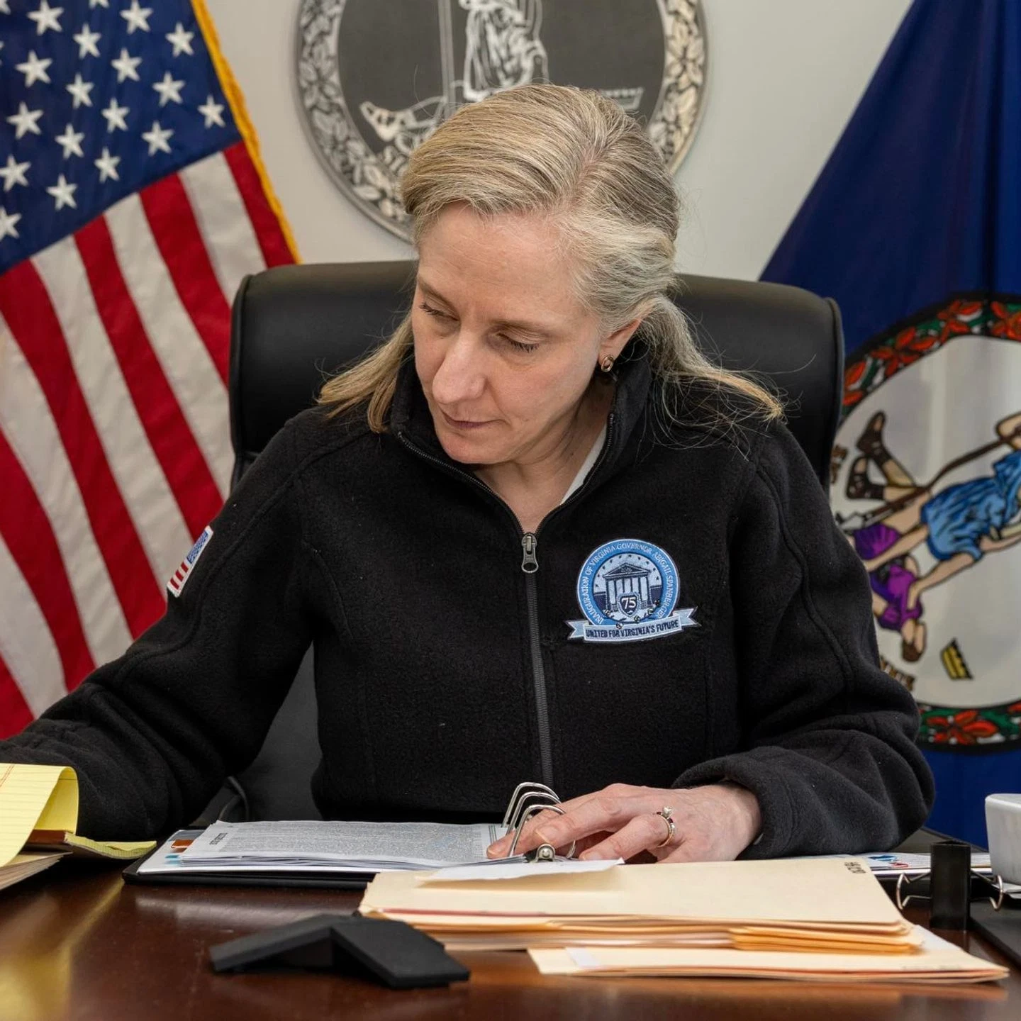
Virginia Policy Watch
One of Virginia’s biggest accessibility victories!
Virginia’s Open Caption Law
(HB 602)
Notes:
Now let's turn to one of the biggest accessibility victories our community has seen in Virginia in recent years.
Many of you have probably heard about House Bill 602, Virginia's Open Caption Law.
When I talk to people about this law today, the question usually isn't, "When does it start?" The question is, "What does it actually mean for me?"
The answer is simple: as of July 1, 2026, covered movie theaters in Virginia are required to offer regularly scheduled open-caption showings. Those showtimes must also be clearly identified so people know which movies are being offered with open captions.
Unlike captioning devices that you check out at the theater, open captions appear directly on the movie screen for everyone to see.
This is a significant step forward because it makes going to the movies more accessible and more spontaneous. Instead of having to request special equipment or wonder whether it will work properly, people have another option available to them.
This law didn't happen by accident. It reflects years of advocacy by members of the Deaf and Hard of Hearing community and our allies across Virginia.
And the best part is this isn't something we're waiting for anymore—it's already in effect.
Let's take a closer look at what this means for our community.

Slide 13
Virginia’s Open Caption Law
What the Law says:
Effective July 1, 2026
Covered movie theaters in Virginia must offer regularly scheduled open-caption showings.
Open-caption showtimes must be clearly identified in theater listings and online.
Open captions are displayed on the movie screen for everyone to see.
This law builds on existing accessibility requirements and expands opportunities for moviegoers who rely on captions.
Notes:
Let's spend just a minute talking about what the law actually requires.
Beginning July 1, 2026, covered movie theaters in Virginia must offer regularly scheduled open-caption showings.
Just as important, those showtimes must be clearly identified in theater listings and online so people can easily find them.
For anyone who isn't familiar with the term, open captions are captions that appear directly on the movie screen for everyone to see. Unlike captioning devices that some theaters loan out, you don't have to request equipment or hope it's working correctly.
This law builds on existing accessibility requirements and expands opportunities for people who rely on captions to enjoy movies with greater independence.
As I mentioned on the previous slide, this is one of the most significant accessibility laws Virginia has passed for the Deaf and Hard of Hearing community in recent years.
And because the law is already in effect, this isn't something we're waiting for—it's something you can use today.
So beyond the legal requirements, what does this actually mean for our community? That's what we'll look at next.

Slide 14
Virginia’s Open Caption Law
What this Means for our Community:
More opportunities to enjoy movies without requesting special equipment.
Easier to attend movies with hearing family and friends.
Greater independence and spontaneity when planning a movie outing.
A recognition that open captions benefit many people—not just those who are Deaf or hard of hearing.
If theaters aren't complying, community feedback helps improve implementation.
Notes:
So, what does Virginia's new Open Caption Law actually mean for our community?
First, it means more choice. People who rely on captions now have regularly scheduled opportunities to enjoy a movie without having to request special equipment or wonder if a captioning device will work.
It also means greater independence. Instead of planning ahead or calling the theater to ask about accessibility, people can simply look for an open-caption showing and attend like anyone else.
This law is also about inclusion. Open-caption movies make it easier for families and friends with different hearing abilities to enjoy a movie together without separating into different accommodations.
And while this law was driven by the Deaf and Hard of Hearing community, the benefits extend well beyond that community. Older adults, people learning English, individuals with auditory processing challenges, and many others also find open captions helpful.
Perhaps most importantly, this law demonstrates that advocacy works. When community members, organizations, and legislators work together, meaningful policy change is possible.
HB 602 isn't the end of the conversation—it's another step toward a more accessible Virginia.

Slide 15
Other Virginia Changes You Should Know About:
✅ Employment & Worker Protections
Disability accommodations and workplace access
✅ Healthcare Access
Communication access and accessible services
✅ Disability & Aging Services
Community-based supports and independence
✅ Education & Transition Planning
Supporting students with disabilities
✅ Housing & Consumer Protections
Accessibility and fair access
✅ Emergency Preparedness
Accessible alerts and public information
✅ State Programs & Agency Decisions
Budgets, regulations, and implementation
Notes:
Virginia's Open Caption Law is one of the most visible accessibility victories we've seen for the Deaf and Hard of Hearing community, but it is important to remember that policy change is much broader than one piece of legislation.
Not every change comes in the form of a new law.
Many of the decisions that affect our community happen through state budgets, agency priorities, regulations, funding decisions, and how existing protections are implemented.
There are several Virginia policy areas that we continue to watch closely.
The first is employment and worker protections.
For Deaf and Hard of Hearing Virginians, employment access continues to be an important issue. This includes reasonable accommodations, effective communication in the workplace, accessible technology, and making sure employers understand their responsibilities under disability rights laws.
As workplaces continue to change—with more remote work, virtual meetings, and new technology—communication access continues to evolve as well.
Healthcare access is another major area we continue to watch.
Communication access in healthcare remains one of the biggest concerns we hear about from our community.
This includes access to interpreters, captioning, accessible telehealth, patient portals, emergency departments, and making sure healthcare providers understand their responsibility to provide effective communication.
Disability and aging services are also important areas to watch.
Virginia continues to make decisions about community-based services and supports that help people remain independent and connected to their communities.
As our population ages, hearing loss will become an increasingly important part of broader conversations about aging, disability, isolation, and access to services.
Education and transition planning continue to matter for Deaf and Hard of Hearing students.
The goal is not only access while students are in school, but also preparing students for employment, higher education, and independent living after graduation.
Emergency preparedness is another area where accessibility is critical.
When emergencies happen, information needs to reach everyone.
Emergency alerts, public health information, evacuation instructions, and safety messages need to be available in accessible formats.
Finally, technology continues to be an area we are watching closely.
Artificial intelligence, captioning tools, and digital services are creating exciting opportunities, but they also raise important questions about accuracy, privacy, and whether accessibility is built in from the beginning.
The important takeaway is this:
Policy is always changing.
Sometimes change happens through a new law, like Virginia's Open Caption Law.
Sometimes it happens through funding decisions, regulations, or how agencies implement existing programs.
At NVRC, part of our role is helping individuals, families, professionals, and community partners understand what is changing, why it matters, and how to stay engaged.

Slide 16
What this Means for You
How these changes may affect:
Individuals & Families
Older Adults
Students
Job Seekers
Employers
Healthcare Providers
Community Organizations
“What Should you do differently?”
Notes:
We've talked about a number of laws, policy changes, and emerging issues today. The question now becomes: What does this mean for you?
The answer depends on who you are.
If you're an individual or family, know your rights. If you need communication access at work, at school, in healthcare, or in your community, don't be afraid to ask for it.
If you're an older adult, take advantage of new technology and services that can help you stay connected, and don't assume hearing loss is simply something you have to live with.
If you're a student, learn about your accommodations and advocate for yourself. Those skills will serve you well throughout your education and into your career.
If you're a job seeker, understand that employers have responsibilities under the ADA, and communication access is part of creating an inclusive workplace.
If you're an employer, think proactively about accessibility. Don't wait until someone requests an accommodation. Creating an inclusive workplace benefits everyone and helps attract and retain talented employees.
If you're a healthcare provider, remember that effective communication is an essential part of quality care. Planning ahead for communication needs leads to better outcomes for both patients and providers.
And if you're part of a community organization, ask yourself whether your programs, meetings, and events are truly accessible. Sometimes small changes can make a big difference.
The biggest takeaway is this: don't wait until accessibility becomes a problem. Whether you're an individual, a business, or an organization, being proactive leads to better communication, greater inclusion, and stronger communities.

Slide 17
Northern VA Policy Watch
A Strong Community Partner
Invests more than $200,000 annually in NVRC
Long-standing commitment to Deaf & Hard of Hearing services
Supports a broad network of disability and aging programs
Fairfax Area Commission on Aging (COA) – Advises on policies, programs, and services for older adults
Disability Services Board (DSB) continues advocating for accessibility and inclusion
Strong partnerships with nonprofits and community organizations
Fairfax County
Notes:
So far, we've looked at policy changes happening at the federal and state levels. Now I'd like to bring things a little closer to home.
One of the reasons NVRC is able to have such a strong impact in our community is because of our partnership with Fairfax County.
Fairfax County has long recognized the importance of communication access and has made it a priority to support programs and services for Deaf and Hard of Hearing residents.
Through the County's partnership with NVRC, we're able to provide hearing screenings, educational workshops, assistive technology demonstrations, outreach programs, and community events that help residents stay informed, connected, and engaged.
The County also understands that accessibility isn't just about complying with laws—it's about removing barriers before they become problems and making sure everyone has the opportunity to participate fully in community life.
That partnership serves as a model for what can happen when local government and community organizations work together.
With that in mind, let's shift our focus to what's happening here in Northern Virginia and take a look at our Northern Virginia Policy Watch—starting with Fairfax County.

Slide 18
Northern VA Policy Watch
2026 Challenges & Changes:
FY27 budget required difficult funding decisions
Some county-funded programs were reduced or restructured
Speech & Hearing Program closed
Golden Gazette transitioned to digital-only
Coordinating Council for the Aging and Adults with Disabilities (CCAAD) dissolved
Community organizations adapted to meet changing needs
Fairfax County
Notes:
Like communities across the country, Fairfax County continues to face new challenges and changing priorities.
The County is balancing the needs of a growing and aging population while responding to increasing demands for healthcare, housing, behavioral health services, transportation, and other essential programs.
At the same time, resources are limited, which means difficult budget decisions have to be made each year. Every department and every nonprofit partner is being asked to demonstrate its impact and use taxpayer dollars effectively.
For organizations like NVRC, that means continually adapting to meet changing community needs while showing measurable results. We're seeing increased demand for education, advocacy, assistive technology, and communication access services, and we're working closely with the County to respond to those needs.
One thing that hasn't changed is Fairfax County's commitment to supporting residents with disabilities. While priorities and programs evolve over time, the County continues to recognize that accessibility and inclusion are essential parts of a strong community.
As we look at some of the County's current priorities, you'll see many opportunities where communication access and disability inclusion continue to play an important role.

Slide 19
Northern VA Policy Watch
Disability & Aging Coalition (DAC)
Founded by former CCAAD members
Independent regional coalition
Co-chaired by
  Naina Narayana Chernoff & Darren Marquardt
Bringing together advocates, nonprofits & community leaders
Advancing regional collaboration & state advocacy
Building on—not replacing—the work that came before
Fairfax County:
Community Takes Action & Leadership
Notes:
One of the lessons we've learned over the past few years is that collaboration doesn't just happen—it has to be intentional.
When the Community Coalition for Action on Aging and Disabilities (CCAAD) dissolved, it left a significant gap. Many organizations had relied on CCAAD as a place to share information, coordinate efforts, and build relationships across the aging and disability communities.
Rather than let that collaboration disappear, organizations came together to create the Disability & Aging Coalition.
Today, the Coalition provides a forum where nonprofits, advocates, service providers, and community leaders can share information, identify emerging issues, and work together to improve services for older adults and people with disabilities.
NVRC is proud to participate in this collaborative effort. It gives us the opportunity to represent the needs of Deaf and Hard of Hearing residents, learn from our partners, and ensure that communication access remains part of broader conversations about aging and disability.
It's a reminder that when one organization disappears, the need doesn't disappear. Sometimes it creates an opportunity for the community to come together in new and meaningful ways.

Slide 20
Northern VA Policy Watch
Balancing Community Needs:
FY2027 budget reflects difficult fiscal choices
Human Services funding redistributed across nonprofit providers
Continued investment in affordable housing & homelessness prevention
Continued support for behavioral health, older adults & disability services
Real estate tax relief maintained for older adults & people with disabilities
NVRC funding reduced by approximately one-third
Community advocacy will help shape future funding priorities
Arlington County
Notes:
Let's take a look at what's happening in Arlington County.
Like many local governments, Arlington faced a challenging budget cycle this year. The FY2027 budget required difficult fiscal decisions as the County worked to balance many competing community needs.
Even with those challenges, Arlington continued to invest in important priorities, including affordable housing, homelessness prevention, behavioral health services, programs for older adults, and disability services. The County also maintained real estate tax relief for older adults and people with disabilities.
One of the decisions the County made was to redistribute Human Services funding across nonprofit providers. As part of that process, NVRC's County funding was reduced by approximately one-third.
While that's certainly a challenge for us, it's important to emphasize that the reduction was not based on our performance. It reflected broader budget decisions affecting many organizations throughout the community.
As we move forward, community advocacy will continue to play an important role in shaping future funding priorities. By sharing the impact of these programs and the value they bring to residents, we can help ensure communication access remains part of Arlington's long-term vision.
This slide is a good reminder that local budget decisions have real impacts on the services nonprofits can provide, making advocacy and community engagement more important than ever.

Slide 21
Northern VA Policy Watch
Growing Through Partnership:
FY2027 adopted a $5.4 billion balanced budget
Property tax rate maintained; vehicle personal property tax reduced
Continued investment in housing, transportation & public safety
Expanded support for older adults, Adult Protective Services & long-term supports
Nearly $4 million invested in competitive Human Services grants
Continued partnership with NVRC to serve Deaf & Hard of Hearing residents
Loudoun remains one of Virginia's fastest-growing communities, increasing demand for accessible services and communication access
Loudoun County
Notes:
Now let's look at Loudoun County.
Loudoun is one of the fastest-growing communities in Virginia, and that growth brings both opportunities and challenges. As the population continues to increase, so does the need for accessible services and communication access for residents who are Deaf, Hard of Hearing, and DeafBlind.
For FY2027, Loudoun adopted a balanced budget of $5.4 billion. The County maintained the property tax rate while reducing the vehicle personal property tax, while continuing investments in important community priorities including housing, transportation, and public safety.
Loudoun also continued to prioritize human services, including expanded support for older adults, Adult Protective Services, and long-term supports. The County invested nearly $4 million through competitive Human Services grants to support community organizations providing essential services.
NVRC is grateful for our continued partnership with Loudoun County. Through this partnership, we are able to provide outreach, hearing screenings, technology demonstrations, education, and other services that help Deaf and Hard of Hearing residents stay connected and engaged.
As Loudoun continues to grow, partnerships like this become even more important. Growth creates new opportunities, but it also means we have to make sure accessibility and communication access grow along with the community.

Slide 22
Northern VA Policy Watch
Building Connections:
FY2027 adopted a $299.6 million balanced budget
Continued investment in the Willard-Sherwood Health & Community Center
Expanded community facilities serving City and County residents
Continued investment in parks, recreation & community wellness
Community input invited on the City's next Parks & Recreation Master Plan
Continued investment in pedestrian safety and multimodal transportation
Human Services funding opportunity (RFP) anticipated Fall 2026
Rock the Block strengthens partnerships among residents, businesses & nonprofits
Growing opportunities for Deaf & Hard of Hearing community engagement
City of Fairfax
Notes:
The City of Fairfax is a unique part of our region because it serves as both a city and a hub for the surrounding Fairfax community.
For FY2027, the City adopted a balanced budget of $299.6 million while continuing investments in facilities, transportation, parks, and community services.
One of the major investments is the Willard-Sherwood Health & Community Center, which represents the City's commitment to creating spaces where residents can access services, build connections, and participate in community life.
The City is also expanding community facilities, continuing investments in parks, recreation, and wellness, and seeking community input on the next Parks & Recreation Master Plan.
For accessibility, these types of investments matter because inclusive communities are built not only through programs, but also through the places where people gather, connect, and participate.
The City is also anticipating future Human Services funding opportunities through an upcoming RFP process, which may create opportunities to expand services and partnerships.
Events like Rock the Block demonstrate the City's focus on bringing residents, businesses, and nonprofits together—and they create opportunities for organizations like NVRC to engage directly with the community.
As the Deaf and Hard of Hearing community continues to grow and become more visible, there are opportunities to strengthen those connections and expand accessibility throughout the City.

Slide 23
Northern VA Policy Watch
Building Momentum for Change:
FY2027 adopted a $979.1 million balanced budget
Tax relief continues for older adults, people with disabilities & veterans
Increased funding for meals for older adults and emergency shelter
Expanded Housing Rental Assistance and affordable housing investments
Increased investment in DASH public transit service
Need for greater investment in Deaf & Hard of Hearing services
Community advocacy will help shape future funding and accessibility priorities
City of Alexandria
Notes:
As we continue our Northern Virginia Policy Watch, Alexandria is an important community to look at because the City has made significant investments in areas that directly impact older adults and people with disabilities.
For FY2027, Alexandria adopted a balanced budget of $979.1 million. The City continues to provide tax relief for older adults, people with disabilities, and veterans, while also increasing investments in areas such as meals for older adults, emergency shelter, housing rental assistance, affordable housing, and DASH public transportation.
These are important priorities, and they show a commitment to supporting residents who may need additional services and resources.
However, when we look specifically at the Deaf and Hard of Hearing community, there is an opportunity for growth.
Alexandria does provide disability services broadly and is committed to ADA accessibility, but there is currently not a dedicated Deaf and Hard of Hearing service structure or program comparable to what NVRC provides.
That means there is an opportunity to build stronger connections—to make sure Deaf and Hard of Hearing residents are included in conversations about aging, disability, healthcare, transportation, and community services.
NVRC has been working to strengthen relationships with Alexandria leadership and raise awareness about the unique needs of residents with hearing loss.
As the City continues shaping future funding and accessibility priorities, our goal is to make sure communication access is part of that conversation and that Deaf and Hard of Hearing residents have a voice in the future of Alexandria.

Slide 24
Northern VA Policy Watch
Planning for the Future:
FY2027 adopted a $2.20 billion balanced budget
Reduced the real estate tax rate while maintaining core County services
Continued investment in older adult services, caregiver support & Medicare counseling
Increased funding for health, housing & community services
Continued investment in transportation, public safety & smart growth
Opportunity to expand Deaf & Hard of Hearing services through community partnerships
Community engagement will help shape future accessibility and communication access
Prince William County
Notes:
Prince William County is another example of a community where growth creates both opportunities and challenges.
For FY2027, the County adopted a balanced budget of $2.20 billion while reducing the real estate tax rate and continuing investments in core County services.
The County continues to invest in areas that are important to the people we serve, including older adult services, caregiver support, Medicare counseling, health, housing, transportation, public safety, and community services.
As one of Virginia's fastest-growing communities, the need for accessible services and communication access will continue to increase.
For NVRC, Prince William represents both an opportunity and a challenge.
We know there are Deaf and Hard of Hearing residents in Prince William County who need access to resources, education, technology demonstrations, advocacy, and community support. At the same time, expanding services into Prince William requires thoughtful planning and sustainable partnerships.
One of the challenges we face is that the County has historically encouraged organizations receiving County support to have a physical presence within the community. For NVRC, establishing a separate office location would represent a significant financial commitment.
Instead, we are exploring partnership opportunities—working with community organizations, local leaders, and others who already have a presence in Prince William—to find ways to expand access responsibly.
The future of accessibility in Prince William will depend on community engagement and collaboration. Our goal is to continue building relationships and finding solutions that bring communication access closer to the residents who need it.

Slide 25
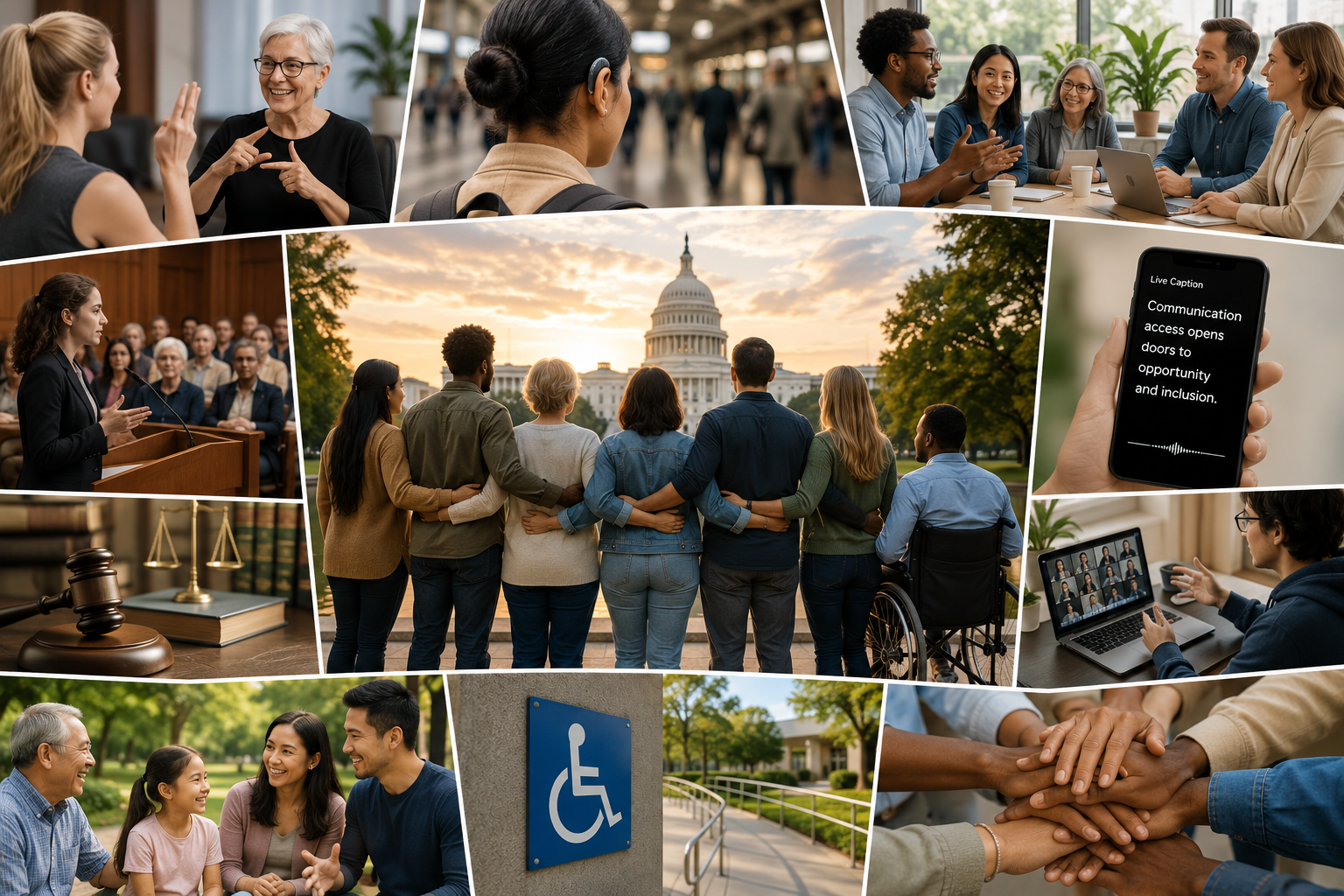
The Big Picture
✅ Progress
New laws are improving communication access.
Local governments continue investing in community services.
Awareness of accessibility continues to grow.
❌ Challenges
Budget constraints require difficult funding decisions.
Access to services still varies by community.
Communication barriers continue to affect everyday life.
➜ Opportunities
Stay informed about policy changes.
Share your experiences with decision-makers.
Work together to build more accessible communities.
Notes:
After looking at each of our local communities, it's helpful to step back and look at the bigger picture.
Across Northern Virginia, we are seeing meaningful progress. Communities are investing in older adults, people with disabilities, healthcare, housing, transportation, and community services. There is growing recognition that accessibility and inclusion need to be part of these conversations.
We have also seen important policy successes, like Virginia's Open Caption Law, and continued investments in programs that help people remain connected and independent.
At the same time, there are challenges.
Local governments are making difficult budget decisions. Nonprofits are being asked to do more with limited resources. Funding priorities change, and organizations like NVRC have to continue demonstrating the impact of our work while adapting to new needs.
For the Deaf and Hard of Hearing community, one of the ongoing challenges is making sure communication access is not an afterthought. Accessibility needs to be included from the beginning—in planning, budgeting, public services, healthcare, and community programs.
But there are also significant opportunities.
We have more awareness than ever before. We have stronger community partnerships. We have new technologies creating additional ways to connect and communicate. And we have a community that continues to advocate, share experiences, and help shape the future.
The biggest takeaway is that progress happens when communities, organizations, and individuals work together. The work is not finished—but there are many reasons to be hopeful about where we are headed.

Slide 26
Creating Change Together
✅ Stay Informed
Know your rights, policies, & available resources.
✅ Get Involved
Attend community meetings, workshops, & local events.
✅ Share Your Experiences
Help decision-makers understand communication barriers & accessibility needs.
✅ Support One Another
Connect with others and strengthen our Deaf & Hard of Hearing community.
✅ Build the Future
Together, we can create more accessible & inclusive communities.
Notes:
Throughout this presentation, we've talked about laws, budgets, programs, and policy decisions—but ultimately, change happens because people get involved.
Creating more accessible communities is not the responsibility of one organization, one government agency, or one group of advocates. It takes all of us.
Stay Informed.
Understanding your rights, knowing what resources are available, and paying attention to changes that affect our community helps us make better decisions.
Get Involved.
Attend community meetings, participate in local events, and connect with organizations working on issues that matter to you.
Share Your Experiences.
Your experiences help community leaders, policymakers, and organizations understand where barriers exist and what needs to change.
Support One Another.
Our community is stronger when we share information, encourage each other, and help people find the resources they need.
Build the Future.
The progress we've seen—from disability rights protections to Virginia's Open Caption Law—happened because people advocated, collaborated, and refused to accept barriers as the status quo.
Every person has a role in creating communities where everyone can communicate, participate, and belong.

Slide 27
Looking Ahead
✅ Continued implementation of the Virginia Open Caption Law
✅ Advances in AI and communication technology
✅ Future federal and state accessibility policies
✅ Local budget and funding decisions
✅ New opportunities to strengthen communication access
Notes:
As we look ahead, the work continues.
Policies will continue to change. New laws will be introduced, communities will face new challenges, and technology will continue to reshape how we communicate and access information.
One thing we know is that accessibility does not happen automatically. It requires continued awareness, advocacy, and collaboration.
For the Deaf and Hard of Hearing community, the opportunities ahead are significant. We are seeing greater recognition of communication access, more conversations about inclusion, and new tools that can help people stay connected.
But we also need to continue making sure that communication access is included from the beginning—not added later as an afterthought.
At the local level, this means continuing to build relationships with counties, cities, community organizations, and decision-makers. It means making sure the needs of Deaf and Hard of Hearing residents are part of broader conversations about aging, healthcare, transportation, technology, and community services.
At NVRC, we will continue to monitor policy changes, share information, advocate for accessibility, and work with our partners to improve communication access throughout Northern Virginia.
The future is shaped by the choices we make today—and everyone has a role in creating communities where people can fully participate and stay connected.

Slide 28

Thank You
Darren Marquardt
Executive Director
Northern Virginia Resource Center for Deaf & Hard of Hearing Persons
📧 execdirector@nvrc.org
🌐 www.nvrc.org
📱 703-352-9055
📍 10467 White Granite Drive, Suite 312, Oakton, VA 22124
Notes:
Thank you, everyone.
As many of you know, I am much more comfortable having conversations with people than standing behind a PowerPoint presentation. (laughs)
Most of my work happens out in the community—meeting people, building relationships, listening, and figuring out where we can make a difference.
But this topic is one I am especially passionate about because policy affects everything we do.
Over the past two years at NVRC, I've had the opportunity to meet with community leaders, elected officials, government staff, nonprofit partners, and advocates across Northern Virginia. I've learned that change doesn't happen because someone writes a law and walks away. It happens because people build relationships, share their experiences, and keep showing up.
The Open Caption Law is a great example of that. It wasn't just a bill—it was a community effort. It involved listening, educating, advocating, negotiating, and working together with legislators and partners to create a change that will impact thousands of Virginians.
That experience reinforced something I believe strongly:
Our voices matter.
Whether we're talking about local budgets, accessibility, healthcare, transportation, or communication access, the people most affected by these decisions need to be part of the conversation.
That's why Policy Watch matters. Staying informed gives us the tools to advocate. Building relationships creates opportunities for change.
Thank you to Fairfax County for supporting this program and making conversations like this possible.
And thank you all for being part of this community. I look forward to continuing these conversations and working together to create more accessible communities.
I'm happy to take questions.

Slide 29
Questions & Discussion
Notes:
Thank you.
I know we covered a lot of information today—from federal disability laws, to Virginia legislation, to what is happening right here in Northern Virginia.
The goal was not to make everyone a policy expert. The goal was to help connect the dots between policy decisions and the things we experience every day: communication access, healthcare, employment, community services, and our ability to fully participate.
I hope you leave with a better understanding of what is changing, why it matters, and how you can stay involved.
I also want to emphasize that policy is not something that happens somewhere else. Our voices, our experiences, and our advocacy help shape what happens next.
So now I would like to open it up for questions, comments, or discussion.
If there are areas you would like to talk more about—local policies, accessibility, NVRC's work, or how to get involved—I would be happy to continue the conversation.
Thank you again for being here.

